Slide 1

Notes:
disclaimer: the photos you'll see in this entire presentation are public and i've also been given permission by the club to show such images; just wanted to put it out there, just in case anyone was wondering
hi everyone! i'll be giving a presentation that's related to the club that i dance and coach at: the melbourne university cheer and dance club (MUCD for short; it's quite a mouthful so that's how i'll be referring to it from now on)
a little bit of background on this club:
- it was established in 2012 with only 24 members
- just for comparison, we now get over 150 members every year
- non-profit club, all the funds from the athletes funds the club itself

Slide 2
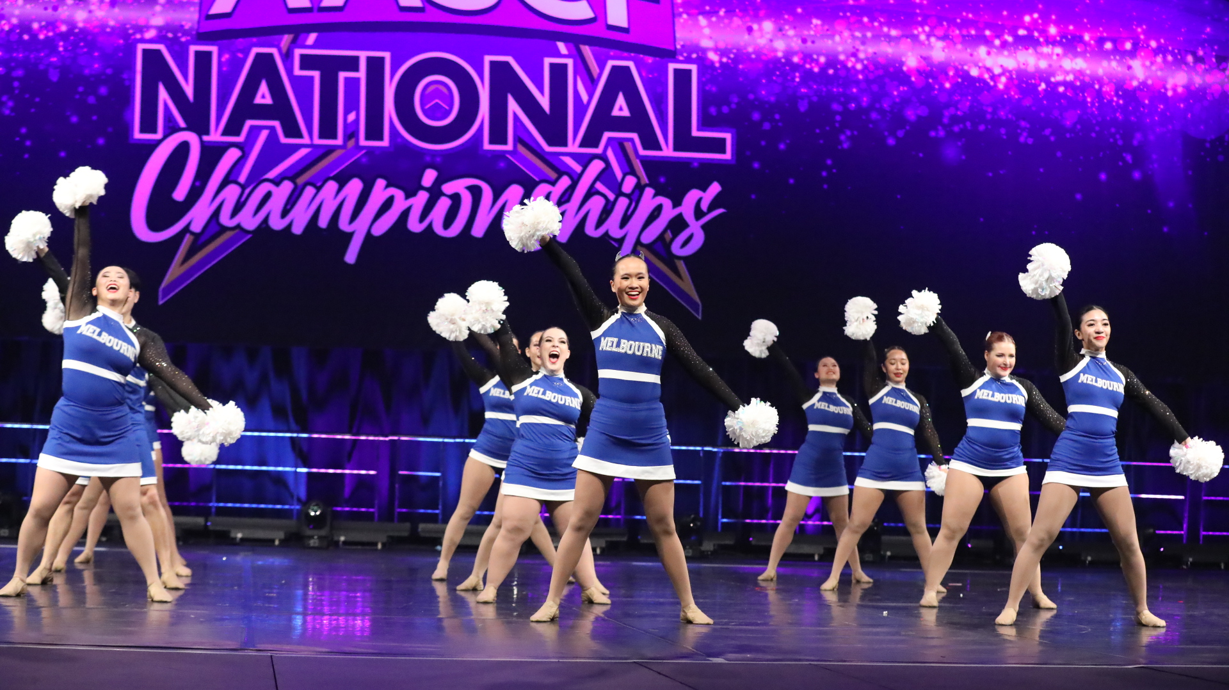
Notes:
now, last year i was approached by the club president, Megan Allis, who'd I'd consider a best friend and work closely with since I coach for the club.
she knew that i was on my way to becoming a web developer and graciously asked me if i could do anything about their current website. I say no problem, chuck me the link and i'll take a look.
just to remind you, this club was founded over a decade ago - the website definitely shows that on certain pages and not long after, i was informed that its design hasn't changed since.
i'll quickly bring up the old website - just so you know, they've shutdown their old website, so i needed to use this handly tool, wayback machine that's pretty much an archive of the entire internet. it lets you see websites from wayback, whether it's shutdown or not.

Slide 3
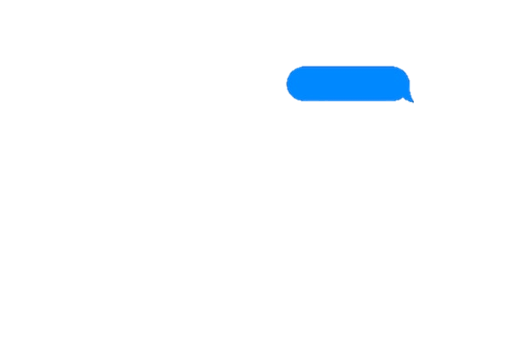
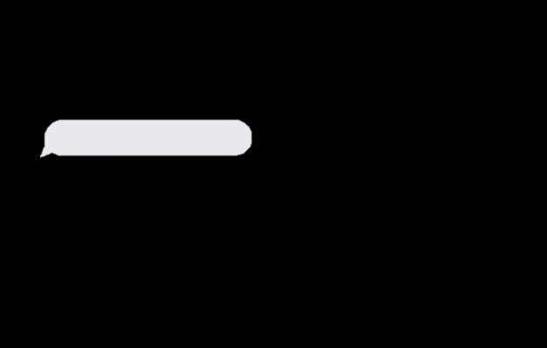

you see what i mean?
…yeah
Notes:
okay, so, i message megan, "hey, I took a look at the club website"
and she just replies with "you see what I mean?"
and I just "yeah"

Slide 4
Improvements
Modern
Aesthetic
Pops of colour
Links back to the university
A reflection of their Instagram page
Notes:
so, that day we got to talking about the website to hash out what she wanted the website to be:
- modern, aesthetic, pops of colour, make it link back the university, basically a reflection of what they've been posting on their instagram page

Slide 5
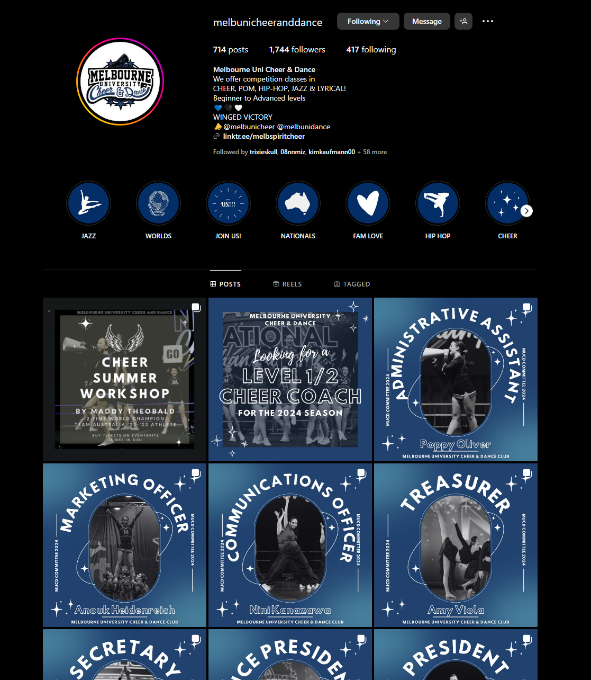
Notes:
this, their instagram page, vs their old website, doesn't exactly match, right?
i go to the drawing board, and by drawing board i mean my best friend Figma, and i put myself to work. after a couple of hours, i managed to come up with a design mockup i was happy with.

Slide 6
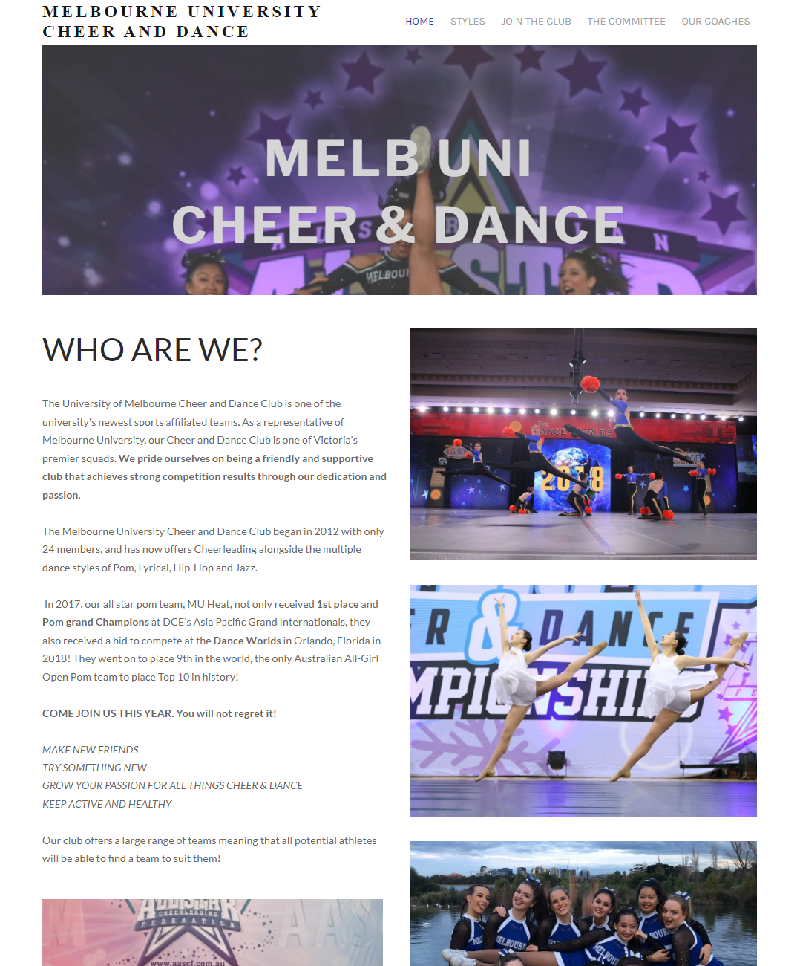
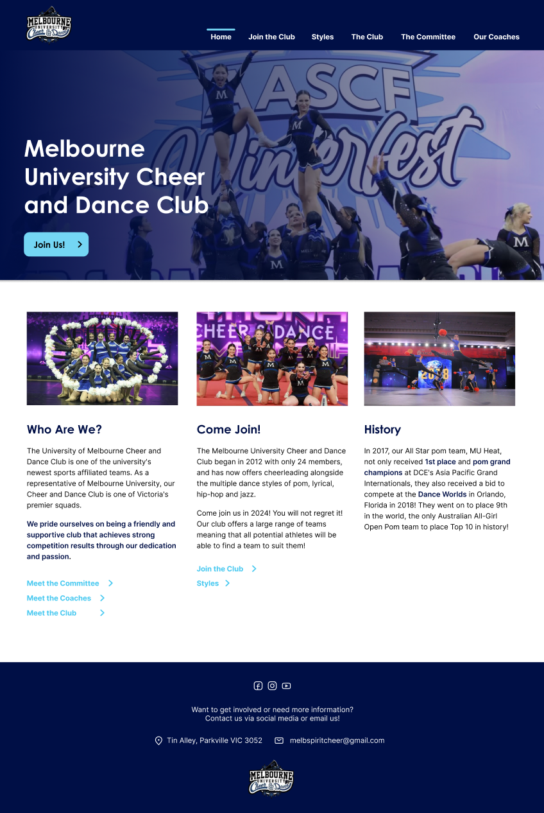
Notes:
and here is the homepage - as you can see, it's not a drastic change, just modernising what the club already had and taking megan's points of discussion into consideration.
one small change that made a huge difference was simply adding colour - putting navy as the background colour for the navbar and the footer, headings, links, and buttons - they made a world of difference. and another change you can see in the new design is how the content is separated. while i was designing i was also keeping the mindset of a React developer:
- what could be a component?
- what could be re-used?
and so you can see on the homepage that the introductory content is split into card-like components.
- the links as well i thought could be a component on their own, as would the join us button.

Slide 7
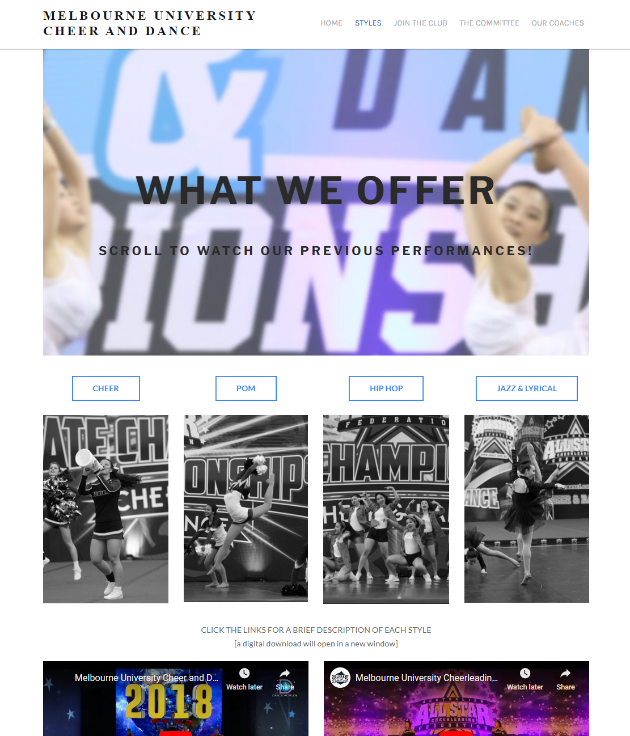
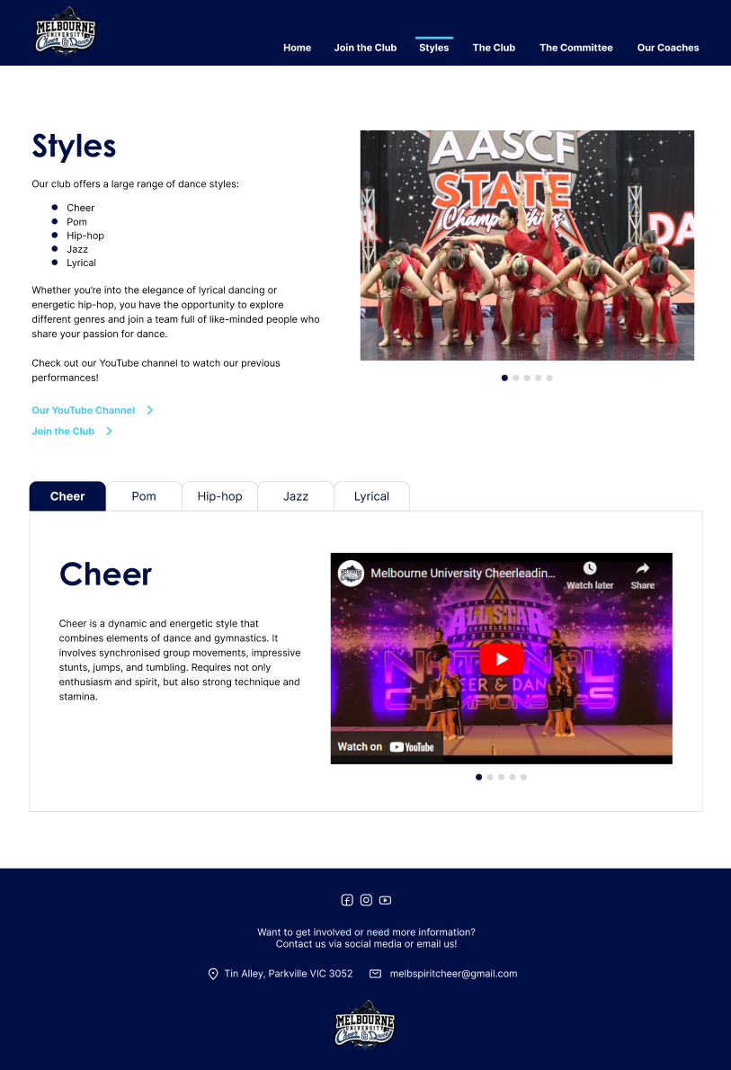
Notes:
here's the Styles page, again, old versus new. one of the key improvements i wanted to make here was to remove the edited image that would open. instead, i replaced this entire section with a tabbed component. when you clicked on a tab, relevant information and videos about the selected dance style would show up. with this design, the content is grouped well, a little bit easier on the eye where there isn't a whole lot of pictures on the page and looks a bit too busy.

Slide 8
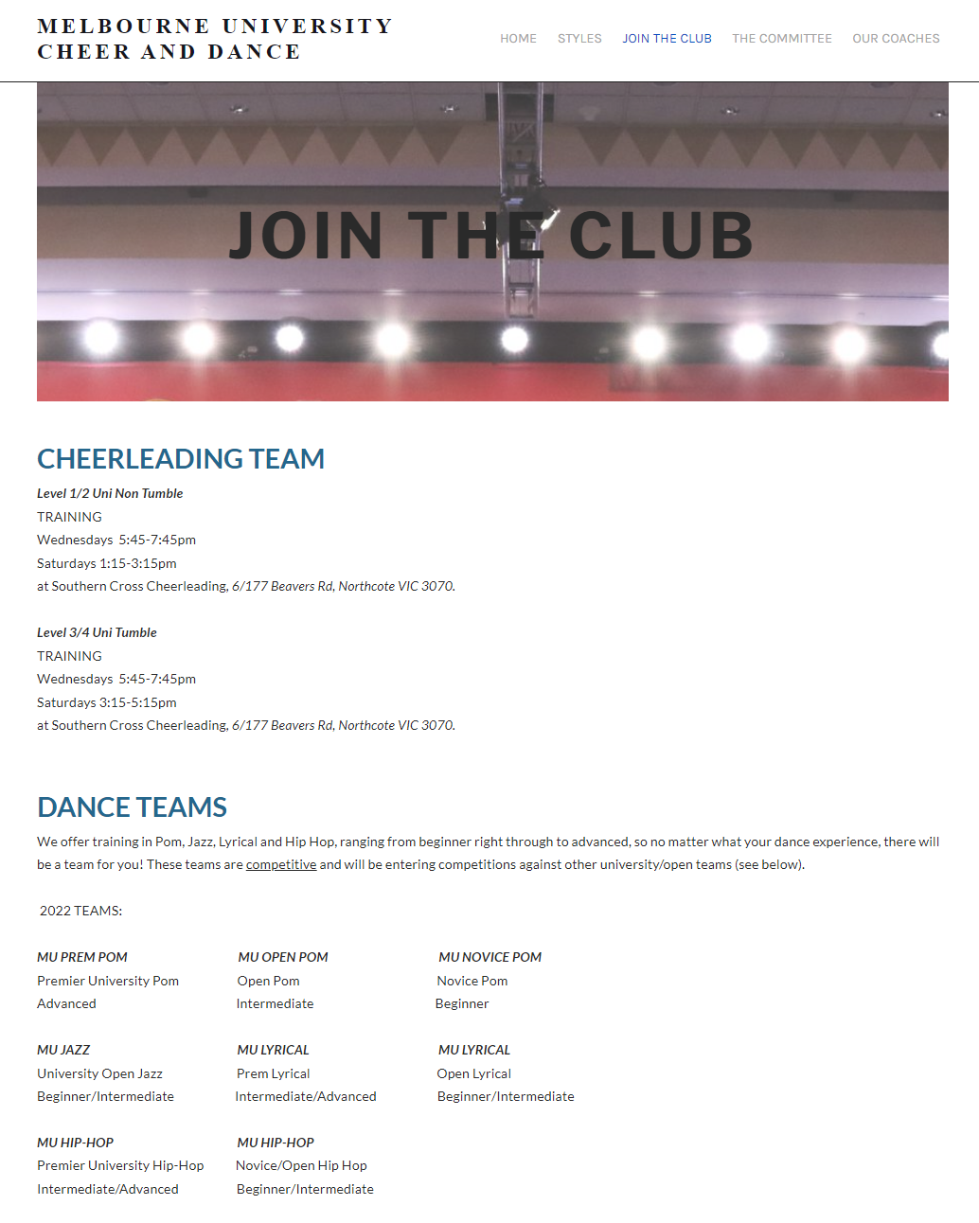
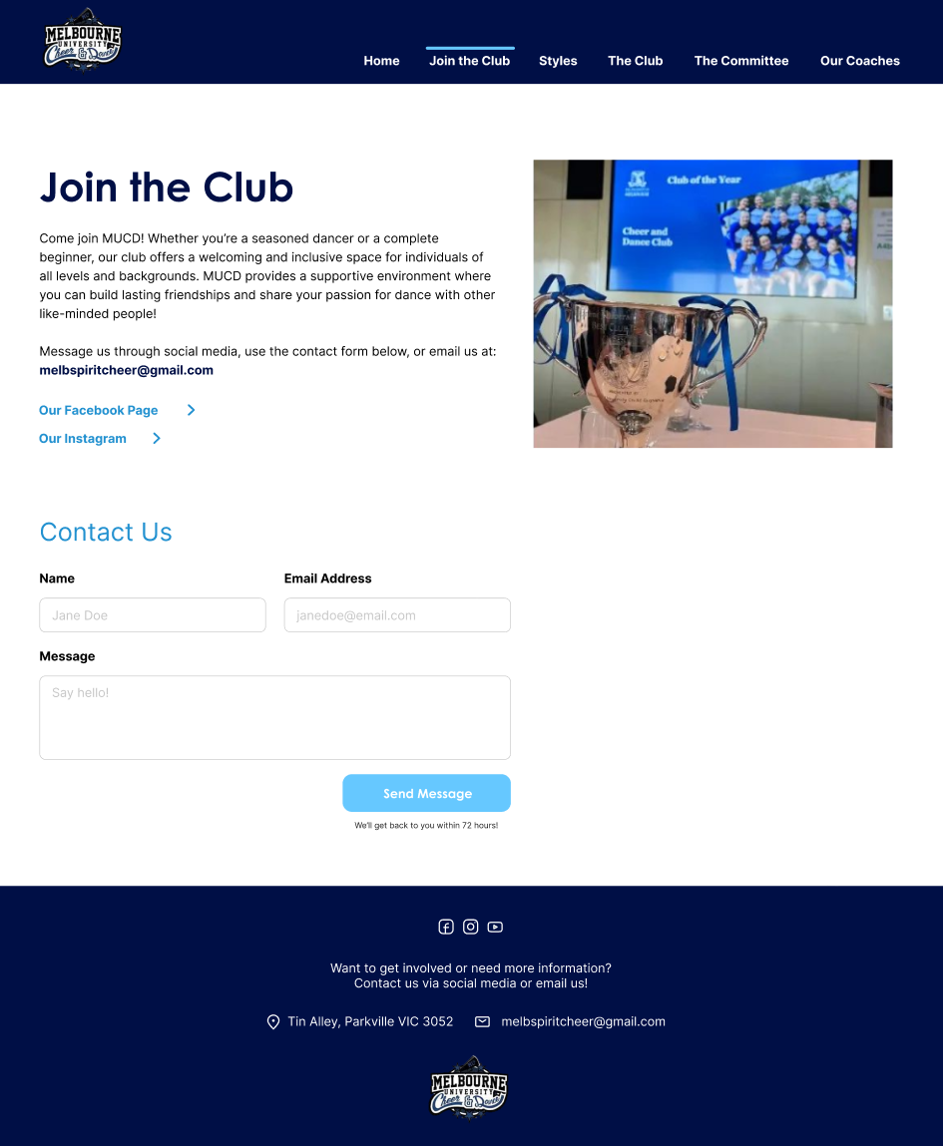
Notes:
here's the join the club page. for this, i decided to change the content that would appear. i approached a bunch of my friends who weren't a part of MUCD and asked what they'd expect on a page called "join the club", and majority of them said information or a form that would allow them to join the club. so, that's what i decided on in the design. on the old website, this page actually showed info about the teams, and where and when they would train. taking on the feedback from my friends, in the mockup of this page, the club's email appears with links to their social media, as well as a form they can submit.
now, the content for this page on the old website would be placed on a completely different page, probably called "Club Information" or "The Club", but this page hasn't been designed yet.

Slide 9
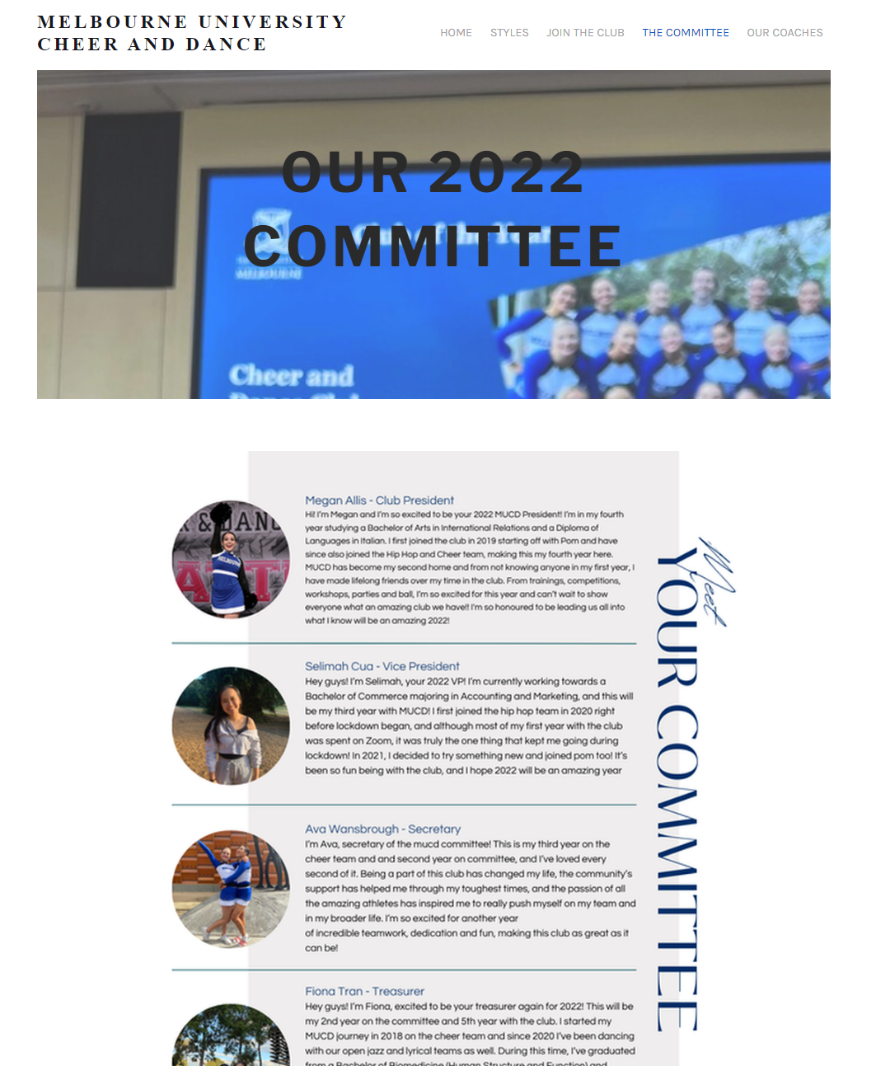
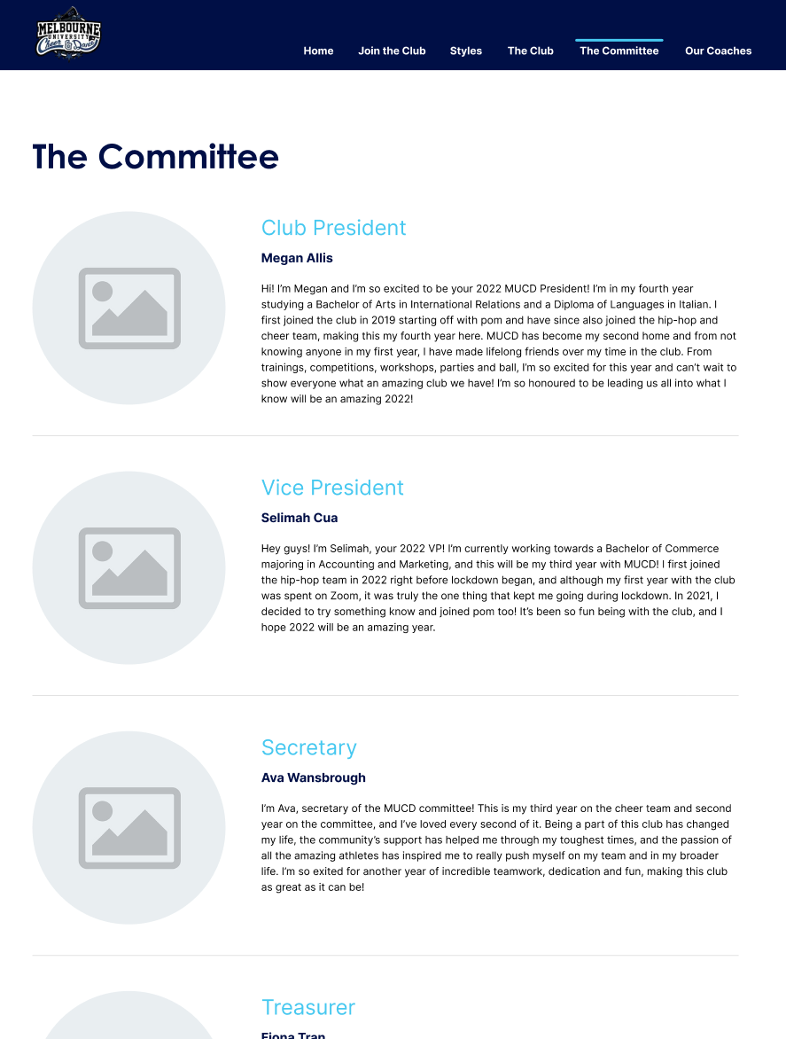
Notes:
so, for the last two pages, which are called "The Committee" and "The Coaches", these look pretty much the same; just the content is different. again, the react-developer mindset is playing around here, you've got a large card component for each person being represented on this page, and the same goes for on the Coaches page.

Slide 10
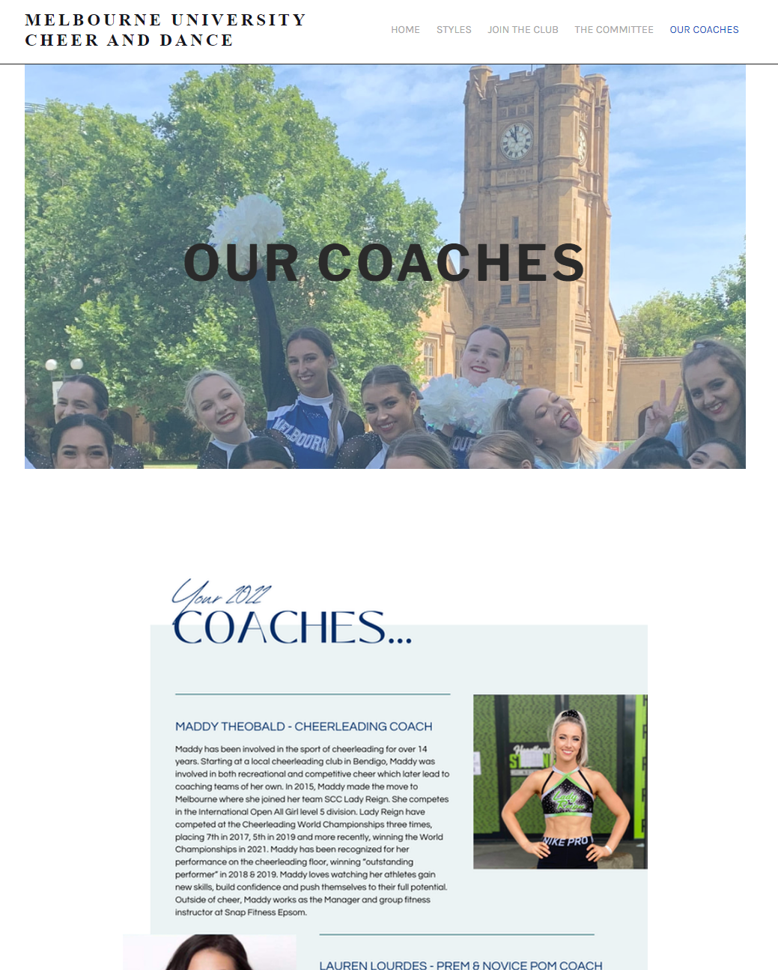
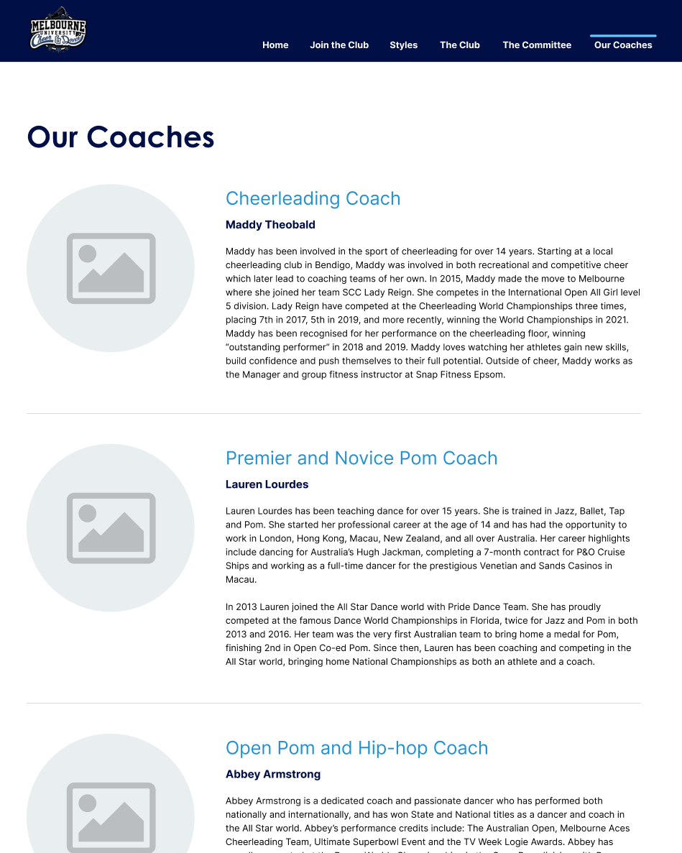

Slide 11

Notes:
and hooray! the design mockup was pretty much done besides the extra page i was going to add. so, I send this over to Megan, and she loves it, sends over a couple of points of feedback such as font, adding small details, etc. Got the greenlight for the design.
now that that's done, where are we at right now?

Slide 12
Where are we now?
Contract currently being drafted
Working out the finances
Slowly (but surely) learning how to host a website on Amazon Web Services (AWS)
In a month or two, a fully functional website
Notes:
well, a contract is currently being drafted up by yours truly (but more of chatgpt, but nobody else needs to know that)
also working out how much i should be being paid for this project - freelancing in general, you're in murky waters, especially when you're working with friends - mates rates. you know, what is that in this scenario? but with the help of alex, this point is clearing up for me, and basically i don't want to sell myself short - nobody does.
learning how to host a website on aws (again, with the help of alex). you see aws a lot and learning how to work with aws is one of the most valuable things i'll get out of this project. so, i'm quite excited about this.

Slide 13
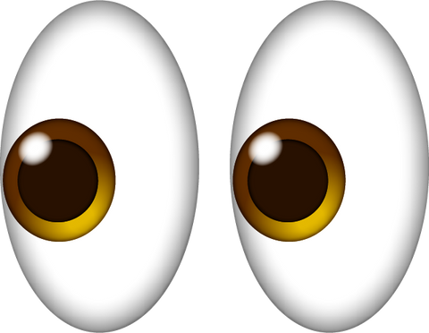
The End :)
Questions?
Notes:
and that is the end of my presentation, hope you guys enjoyed! If you’ve got any questions, happy to answer them!

